Slide 1




Flutter – Lecture 1

Slide 2
This course will teach you, how to develop a mobile app with the help of Dart (Programming Language) + Flutter (Mobile UI Framework).

Slide 3
Topics to be Covered
We will Cover :
What is Flutter?
Why we use Flutter?
Flutter Architecture
Flutter Alternatives
Flutter Versions

Slide 4
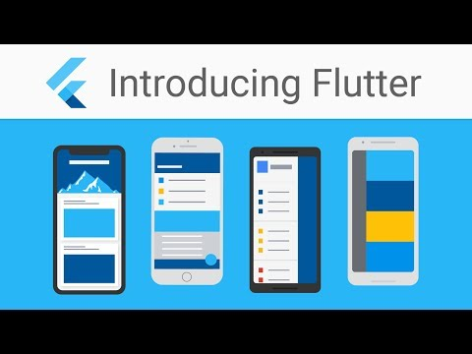
What is Flutter?
Flutter is Google’s UI toolkit for building beautiful, natively compiled applications for mobile, web, and desktop from a single codebase.
Notes:
Flutter in native language is an app SDK by Google which can help you code for Android as well as iOS on a single codebase. It is used for building high-performance apps for Android, iOS, Web and Desktop.

Slide 5
Why Flutter?
One code base to rule them all. You only need to know one programming level Dart, which is very powerful language similar to JavaScript.
Fast Development
Native Performance : Flutter provides various pre-defined widgets and classes for a full native feel of the app on Android or on iOS.
It provide Fast development by offering hot reload
Notes:
A simple and Flexible layout system : Remember one thing before anything, that Everything is a Widget in Flutter.
A widget is a building block for your user interface. Using widgets is like combining Legos. Like Legos, you can mix and match widgets to create something amazing.

Slide 6
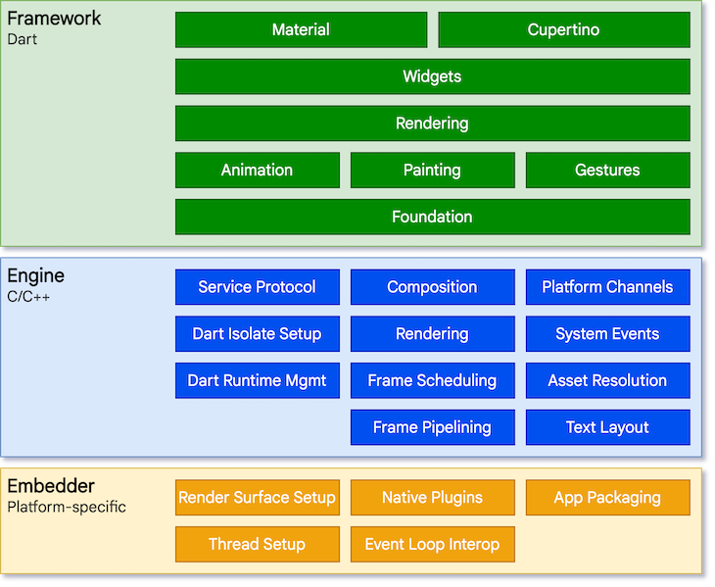
Flutter Architecture
Notes:
The layer model: The pieces from which Flutter is constructed.
Reactive user interfaces: A core concept for Flutter user interface development.
An introduction to widgets: The fundamental building blocks of Flutter user interfaces.
The rendering process: How Flutter turns UI code into pixels.
An overview of the platform embedders: The code that lets mobile and desktop OSes execute Flutter apps.
Integrating Flutter with other code: Information about different techniques available to Flutter apps.
Support for the web: Concluding remarks about the characteristics of Flutter in a browser environment.
Flutter is designed as an extensible, layered system. It exists as a series of independent libraries that each depend on the underlying layer. No layer has privileged access to the layer below, and every part of the framework level is designed to be optional and replaceable.

Slide 7
Flutter Architecture
The flutter architecture based on three layered system.
Framework (Dart): where developers interact with Flutter is written in the Dart language. It functions as a sequence of independent libraries, with each of them depending on the underlying layer
Engine (C/C++):The engine layer is written in C/C++, and it takes care of the input, output, network requests, and handles the difficult translation of rendering
Embedder: This layer provided by a platform-specific embedder, which coordinates with the underlying operating system.
Flutter code can be embedded into an existing application as a module or as the complete application’s content using the embedder.

Slide 8
Flutter Alternatives
Flutter
vs
React native
vs
Xamarin
Notes:
What’s the best framework for cross-platform mobile app development? Let’s compare the top three options developers consider before starting a new project

Slide 9
React native
React Native
An open-source UI software framework created by Facebook in 2015.
Used to develop applications for both Android and IOS.
React Framework, a JavaScript library along with native platform is used to develop applications.
Allows developers to use developers to write native code in languages such as Java or Kotlin for Android, Objective-C or Swift for IOS which makes it even more flexible.

Slide 10
Flutter
Flutter
Released by Google in 2017.
Used to develop applications for both Android and IOS.
Flutter uses Dart language. Dart is client-optimized language for developing fast apps on any platform.
According to 2020 Developer Survey, Flutter is much more loved than Xamarin with a staggering 68.8 percent of developers expressing interest in developing applications with Flutter.

Slide 11
Xamarin
Xamarin
Xamarin is a cross-platform mobile app development framework owned by Microsoft based on Mono, a free and open-source .NET framework.
Founded by engineers in 2011 and later acquired by Microsoft in 2016.
Apps are developed using C# language and Microsoft Visual Studio tool is used.

Slide 12

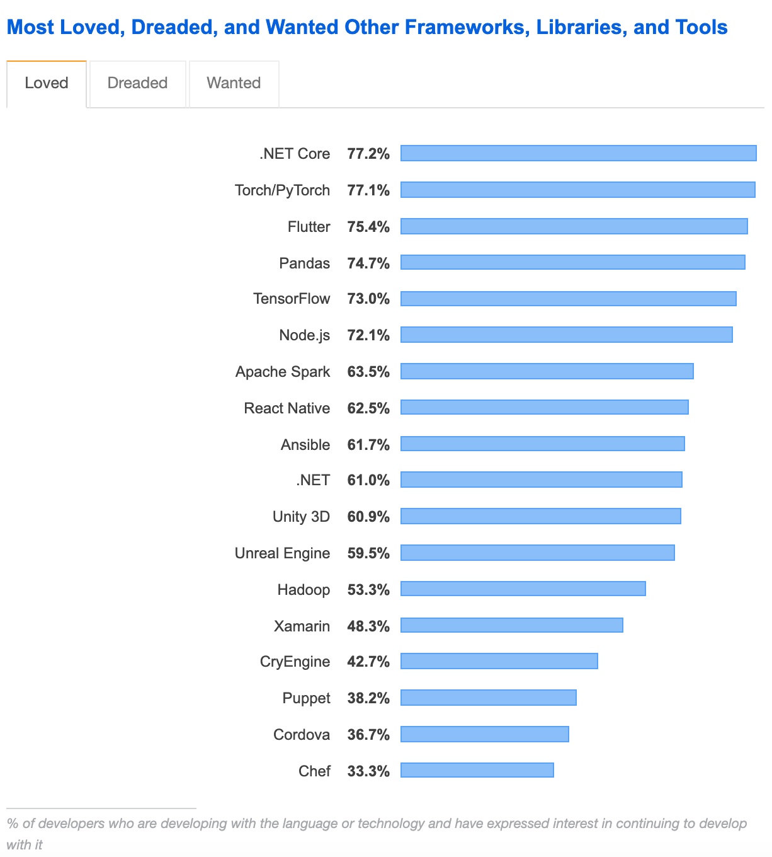
Comparison (React native VS Flutter)
According to the survey of most loved frameworks on stack overflow in 2020, Flutter was more favored by developers than React Native

Slide 13
Flutter Version
The first version of Flutter was unveiled at the 2015 Dart developer summit. The first stable release was delivered on the 4 of December 2018 and on May 6, 2020, the Dart SDK version 2.18 and Flutter version 1.17 were released delivering a build with Material API integration.
Currently Flutter 2.10 is here

Slide 14
Summary
Today we have learned about:
Flutter App Development (Course Orientation)
Introduction to Flutter App Development
Flutter Architecture / Alternative / Version

Slide 15
In Next Lecture:
We will Cover:
First App Tree
Flutter Project Folder Structure & Description

